Slide 1
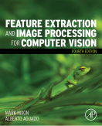
COMP3204 & COMP6223 Computer Vision
Welcome!
Mark Nixon and Jonathon Hare
 | Book Intro

Slide 2

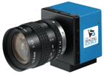

Vision based biometrics
John

Slide 3
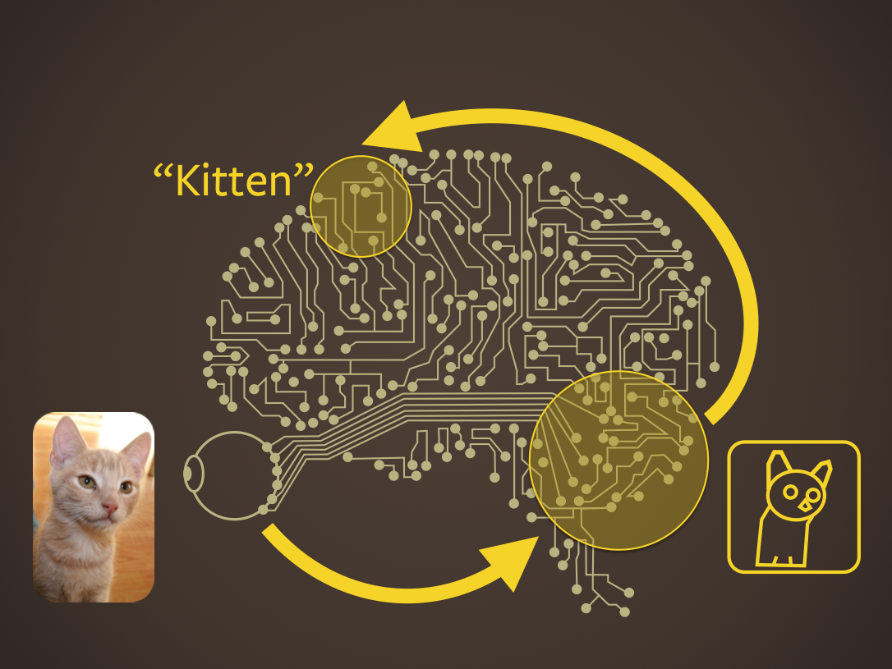

Slide 4
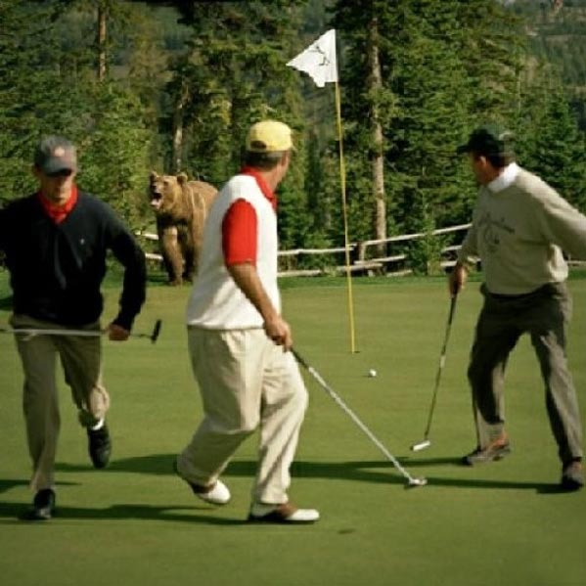
What can image analysis achieve?

Slide 5

Key to our slides
This bit is to be found in Mark’s book
We expect you to remember this stuff
If neither of these are there, this is stuff to illuminate the course material

Slide 6
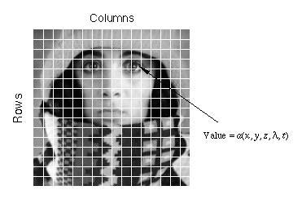
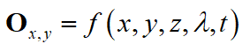
Images consist of picture elements known as “pixels”
time
colour
location
depth

Slide 7

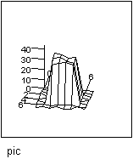
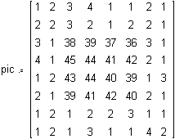
2D Images are matrices of numbers
Grey level image
3D view
Corresponding Matrix
Pixel

Slide 8


Point Operations
Recalculate point values
Modify brightness
Find Intensity

Slide 9
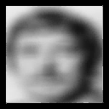
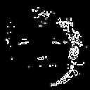
Group Operations
Process neighborhoods
Image filtering
Edge detection

Slide 10
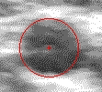
Feature Extraction
Finds shapes
Roads in remotely-
sensed image
Artery in
ultrasound image

Slide 11
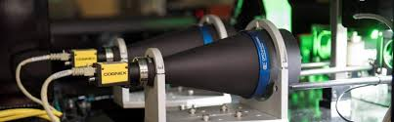
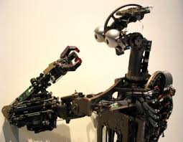
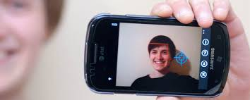
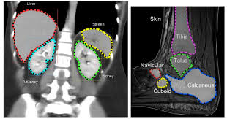
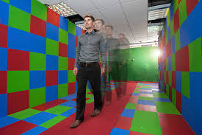
Applications of Computer Vision
Image coding (MPEG/JPEG)
Product inspection
Robotics
Modern cameras/ phones
Medical imaging
Demography (applied politics?)
Biometrics (recognising people)

Slide 12


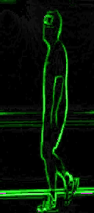
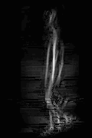
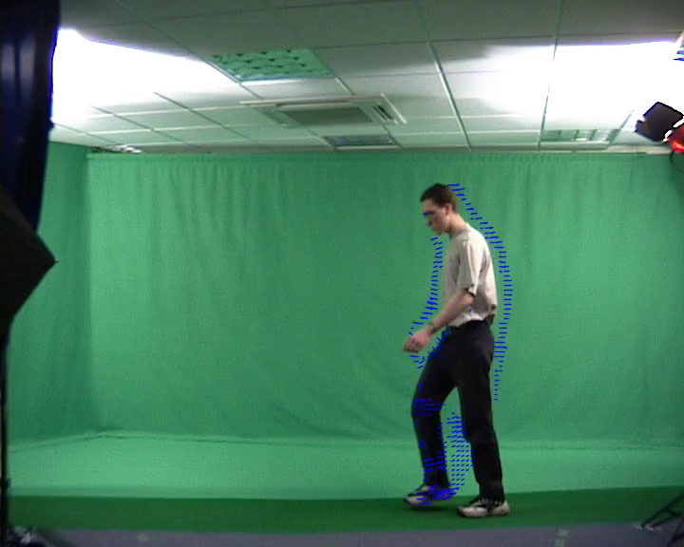
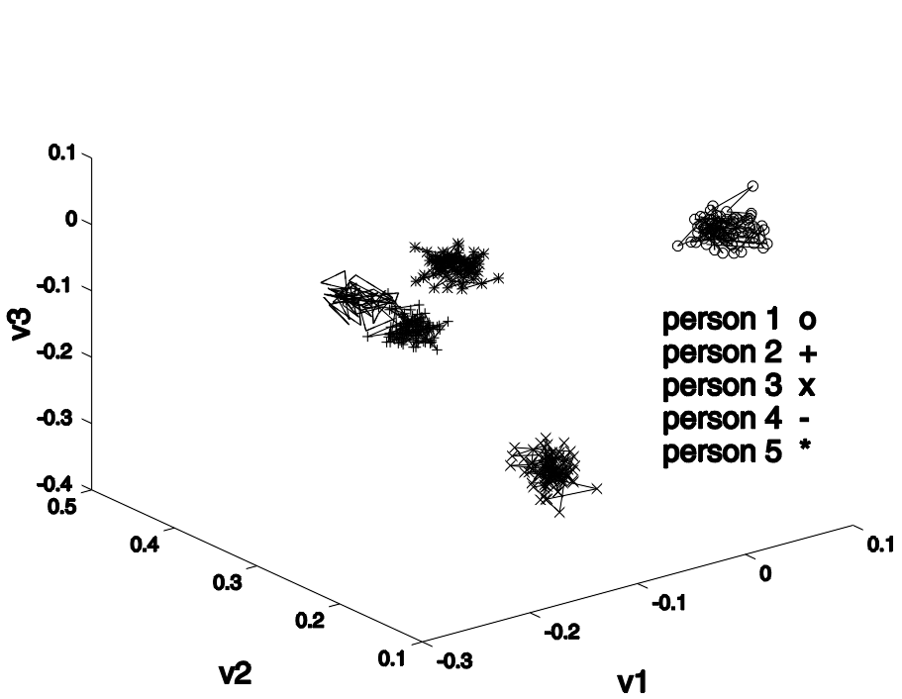



Gait Recognition
Recognising people from the motion of the whole body
silhouette
flow
edges
symmetry
acceleration
feature space

Slide 13
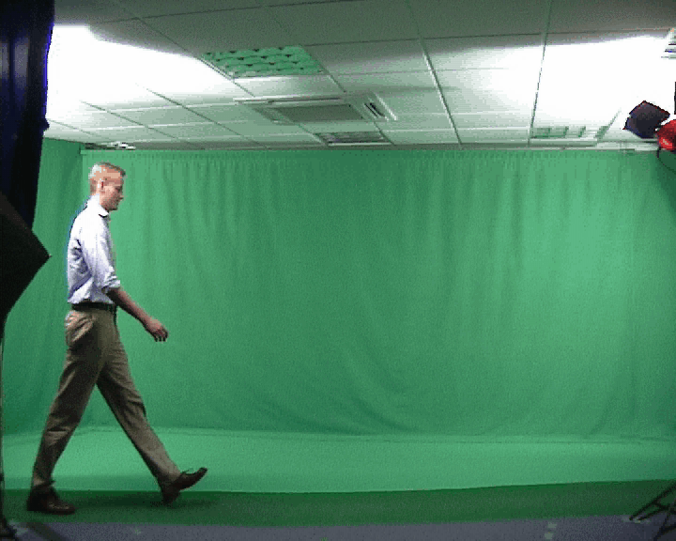
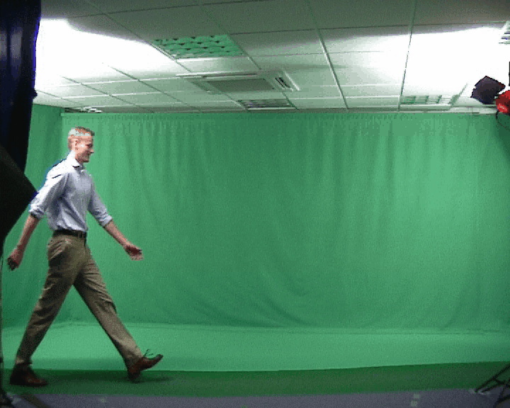
Gait Recognition
natural walking (well….)

Slide 14
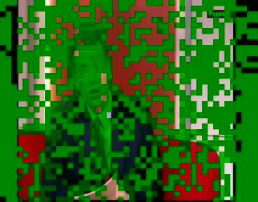
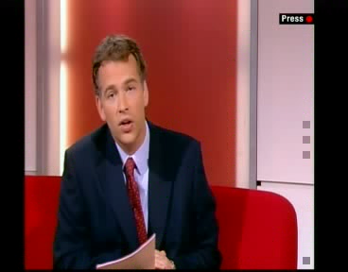
Ear biometrics
Person identification from ear image
Uniqueness: used in forensics
Unique advantage: age invariant
Unique disadvantage: hair!
Much smaller field than gait recognition
Thanks, BBC1

Slide 15
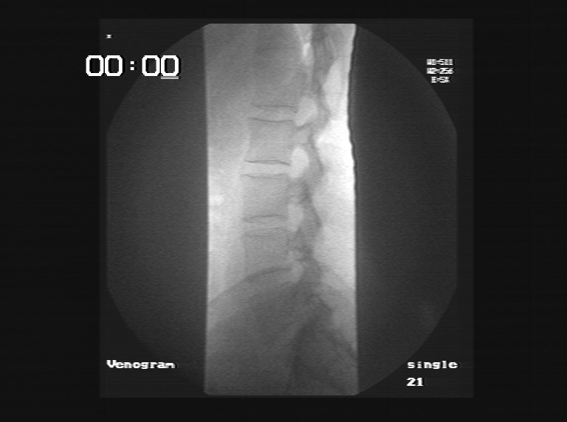
Digital videofluoroscopic Imaging

Slide 16
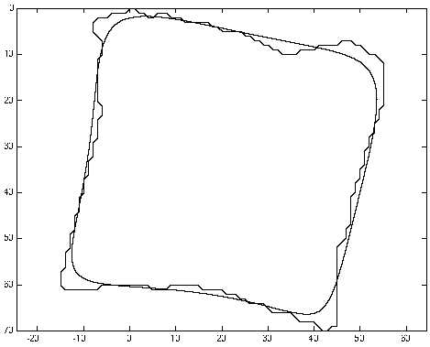

High level feature extraction

Slide 17
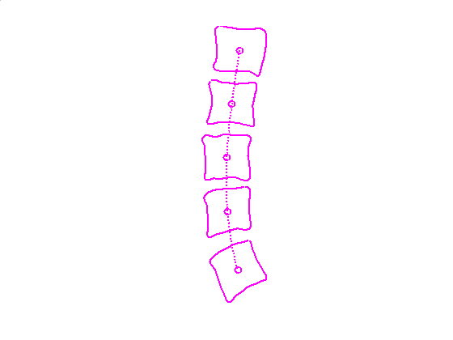
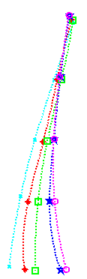
Animated extraction

Slide 18
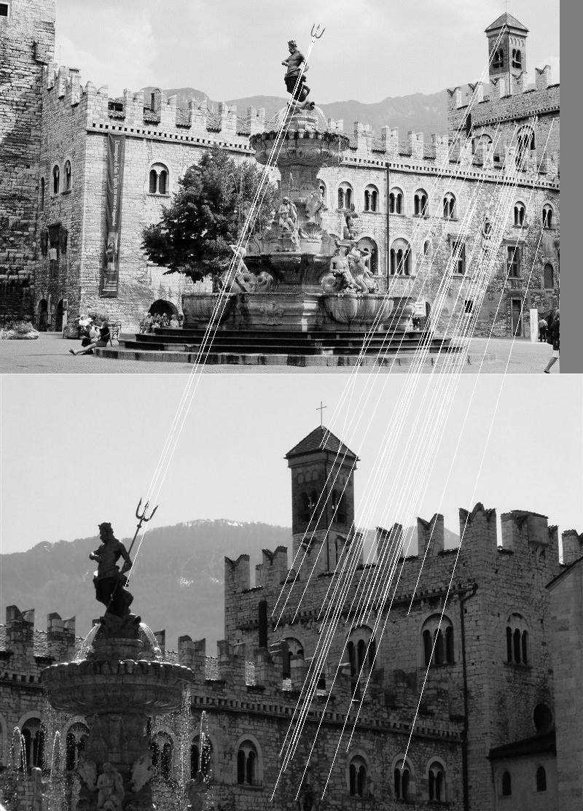
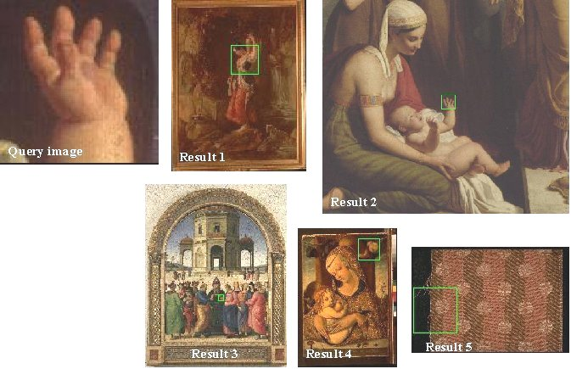
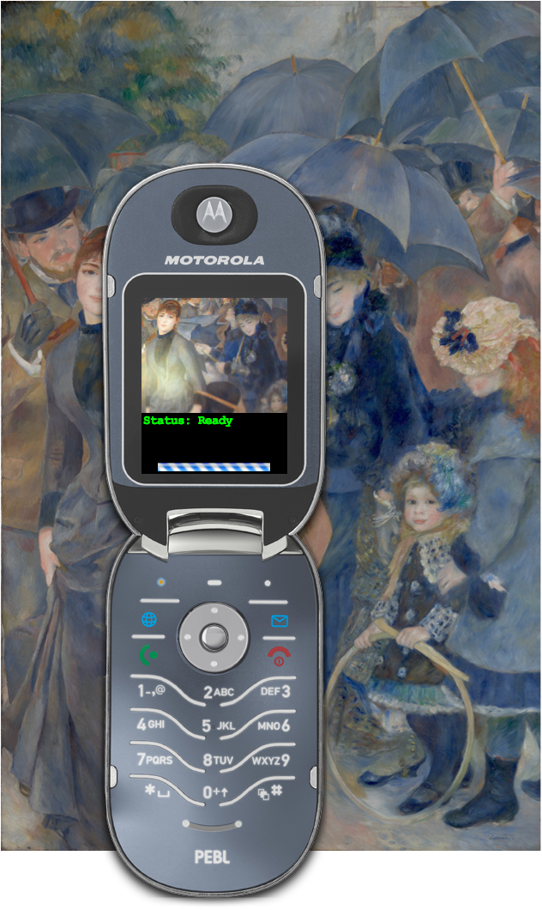
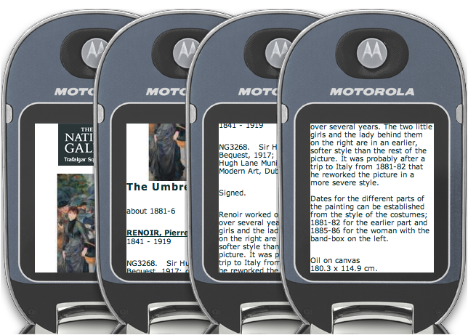
Content-based retrieval and image matching

Slide 19
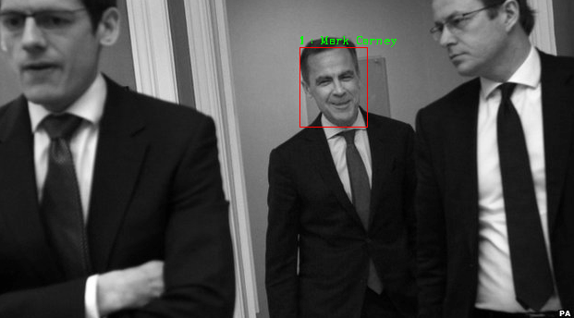
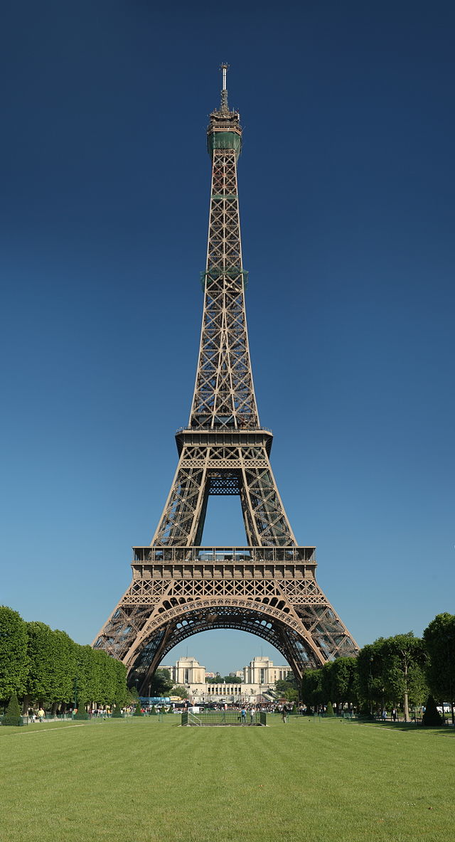
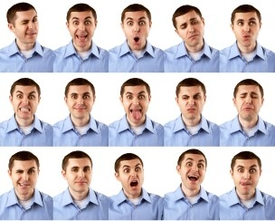
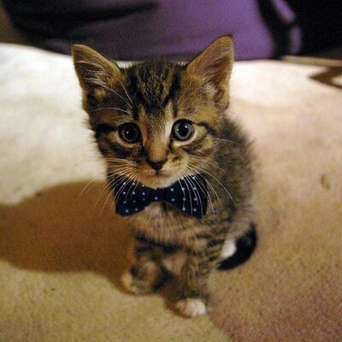
Higher level visual cognition
Who?
What?
Where?
Why?

Slide 20
Computer vision support
WWW homepages
http://comp3204.ecs.soton.ac.uk (for 3204 and 6223)
Lecture support materials
Links
Notes
Tutorials (on demand)
Book

Slide 21

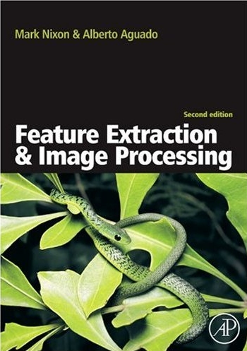
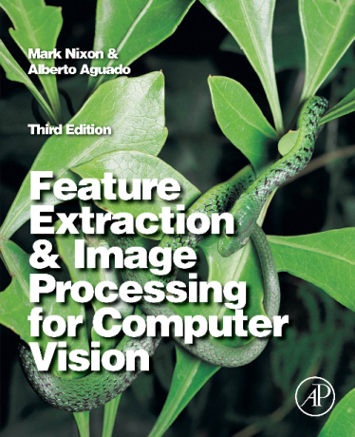
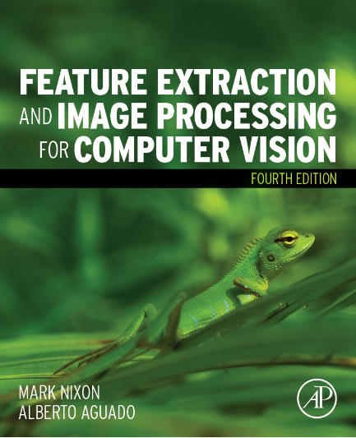
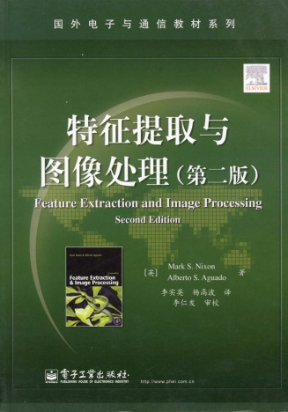
Computer vision support
https://www.southampton.ac.uk/~msn/book/
1st Edition 2002; 2nd Edition 2008, 3rd Edition 2012 in Library (and electronic)
4th Edition 2019 (Current price ~ £69 Amazon) It must drop. Is this the Brexit price?
CONTENTS
Introduction
Images, sampling and frequency domain processing
Basic image processing operations
Low-level feature extraction (including edge detection)
Feature extraction by shape matching
Flexible shape extraction (snakes and other techniques)
Object description
Region Based Analysis
Moving Object Extraction and Description
Camera Geometry Fundamentals
Colour Images
Distance, Classification and Learning

Slide 22
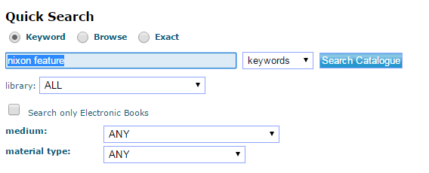
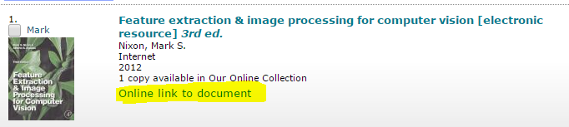
Direct from the Library!!
In webcat https://www-lib.soton.ac.uk/ I have searched for your book
If off campus the students need to use the VPN or Southampton virtual environment - then click on the highlighted link to access the full text of the book. This is not available on kindles etc

Slide 23
Lecture Support (Mark)
Slides (pdf) available online
The 4th Edition is out now so
Matlab and Python from Book
Used in lectures
Bonus is for you only!!!

Slide 24
Lecture Support (Jon)
Interactive slides with many demos
(often using a webcam to capture images)
Available for you to download and run
Source code on github
(more info when you get to Jon’s lectures)
Handouts*

Slide 25
Assessment
Mixture of coursework and final exam
COMP3204: 60% exam; 40% coursework
COMP6223: 55% exam; 45% coursework
(exam questions are the same! The exams are concurrent)

Slide 26
Coursework
Three courseworks
2 individual
1 in pairs (competition format)
Much requested feature!
Designed to support learning
Has worked really well since introduced
Different coursework assignments for COMP3204 and COMP6223 students

Slide 27
COMP3204:
No 1: Set today! handin wk 9; fb by wk 11
No 2: Set wk 2; handin wk 6; fb by wk 9
No 3: Set wk 7; handin wk 11; fb by wk 12 (In pairs)
COMP6223:
No 1: Set wk 2; handin wk 6; fb by wk 9
No 2: Set wk 3; handin wk 8; fb by wk 11
No 3: Set wk 7; handin wk 11; fb by wk 12 (In pairs)

Slide 28
Lecture Timetable
This course has 24 lectures of stuff
Mark will start next tomorrow for 3 and a bit weeks [10 lectures]
Jon will then take over for 5 weeks
Mark will reappear later
We’ll run revision lectures after Xmas

Slide 29
Finally
Enjoy!
Mark Nixon
msn@ecs.soton.ac.uk
Office: 32/3016
Jonathon Hare
jsh2@ecs.soton.ac.uk
Office: 32/4043

